Slide 1
Naïve Bayes Classification

Slide 2
Naïve Bayes Classification
Naive Bayes is among one of the most simple and powerful algorithms for classification based on Bayes’ Theorem
Based on an assumption of independence among predictors.
Naive Bayes model is easy to build and particularly useful for very large data sets.

Slide 3
Naïve Bayes Classification
There are two parts to this algorithm
Naive
Bayes

Slide 4
Naïve Bayes Classification
The Naive Bayes classifier assumes that the presence of a feature in a class is unrelated to any other feature.
All of these properties independently contribute to the probability that a particular fruit is an apple or an orange or a banana and that is why it is known as “Naive”
In Statistics and probability theory, Bayes’ theorem describes the probability of an event, based on prior knowledge of conditions that might be related to the event.

Slide 5
Tasks-Applications
Spam Classification
Given an email, predict whether it is spam or not
Medical Diagnosis
Given a list of symptoms, predict whether a patient has disease X or not
Weather
Based on temperature, humidity, etc… predict if it will rain tomorrow

Slide 6

Given a Hypothesis H and evidence E, Bayes’ Theorem states that the relationship between the probability of Hypothesis before getting the evidence P(H) and the probability of the hypothesis after getting the evidence P(H|E) is :

Slide 7
This relates the probability of the hypothesis before getting the evidence P(H), to the probability of the hypothesis after getting the evidence, P(H|E).
P(H) is called the prior probability, while P(H|E) is called the posterior probability. The factor that relates the two, P(H|E) / P(E), is called the likelihood ratio.

Slide 8
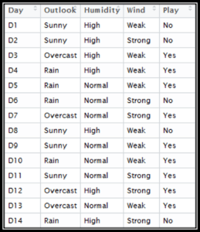
Data, which comprises of the Day, Outlook, Humidity, Wind Conditions and the final column being Play, which we have to predict.

Slide 9
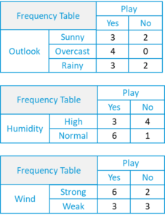
create a frequency table using each attribute of the dataset.

Slide 10
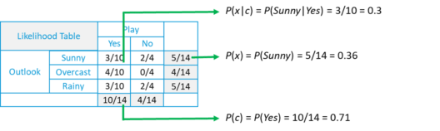
Each frequency table, we will generate a likelihood table

Slide 11
Likelihood of ‘Yes’ given ‘Sunny‘ is:
P(c|x) = P(Yes|Sunny) = P(Sunny|Yes)* P(Yes) / P(Sunny) = (0.3 x 0.71) /0.36 = 0.591
Similarly Likelihood of ‘No’ given ‘Sunny‘ is:
P(c|x) = P(No|Sunny) = P(Sunny|No)* P(No) / P(Sunny) = (0.4 x 0.36) /0.36 = 0.40

Slide 12
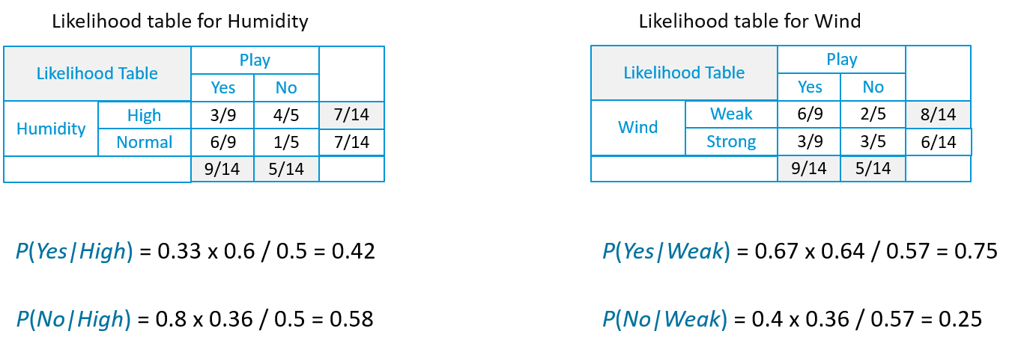

Slide 13
Suppose we have a Day with the following values :
Outlook = Rain
Humidity = High
Wind = Weak
Play =?

Slide 14
Likelihood of ‘Yes’ on that Day =
P(Outlook = Rain|Yes)*P(Humidity= High|Yes)* P(Wind= Weak|Yes)*P(Yes)
= 2/9 * 3/9 * 6/9 * 9/14 = 0.0199
Likelihood of ‘No’ on that Day =
P(Outlook = Rain|No)*P(Humidity= High|No)* P(Wind= Weak|No)*P(No)
= 2/5 * 4/5 * 2/5 * 5/14 = 0.0166
Now we normalize the values, then
P(Yes) = 0.0199 / (0.0199+ 0.0166) = 0.55
P(No) = 0.0166 / (0.0199+ 0.0166) = 0.45
Our model predicts that there is a 55% chance there will be a Game tomorrow.

Slide 15
Bayesian Classification
Problem statement:
Given features X₁,X₂,…,X_{n}
Predict a label Y

Slide 16
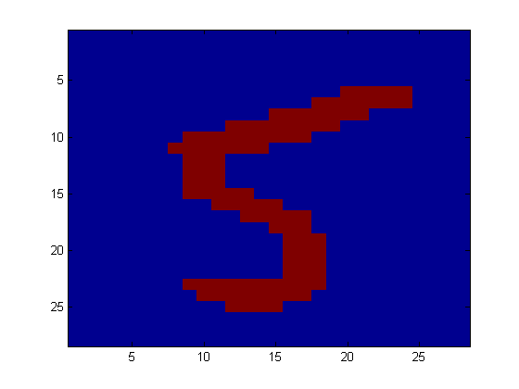
Another Application
Digit Recognition
X₁,…,X_{n} ∈ {0,1} (Black vs. White pixels)
Y ∈ {5,6} (predict whether a digit is a 5 or a 6)
Classifier
5

Slide 17
The Bayes Classifier
for example: what is the probability that the image represents a 5 given its pixels?
So … How do we compute that?

Slide 18
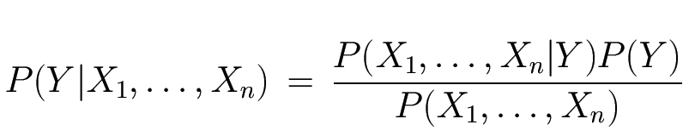
The Bayes Classifier
Likelihood
Prior
Use Bayes Rule!
Why did this help? Well, we think that we might be able to specify how features are “generated” by the class label
Normalization Constant

Slide 19
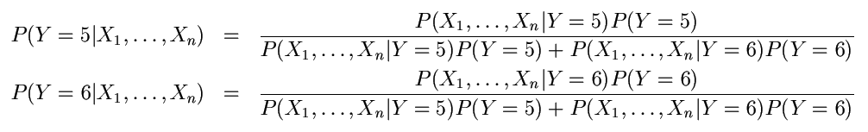
The Bayes Classifier
Let’s expand this for our digit recognition task:
To classify, we’ll simply compute these two probabilities and predict based on which one is greater

Slide 20
Model Parameters
For the Bayes classifier, we need to “learn” two functions, the likelihood and the prior
How many parameters are required to specify the prior for our digit recognition example?

Slide 21
Model Parameters
How many parameters are required to specify the likelihood?
(Supposing that each image is 30x30 pixels)
?

Slide 22
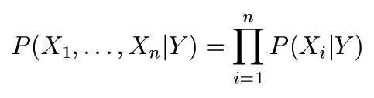
The Naïve Bayes Model
The Naïve Bayes Assumption: Assume that all features are independent given the class label Y
Equationally speaking:

Slide 23
Why is this useful?
# of parameters for modeling P(X₁,…,X_{n}|Y):
2(2^{n}-1)
# of parameters for modeling P(X₁|Y),…,P(X_{n}|Y)
2n

Slide 24
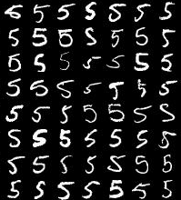
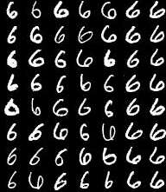
Naïve Bayes Training
Now that we’ve decided to use a Naïve Bayes classifier, we need to train it with some data:
MNIST Training Data

Slide 25
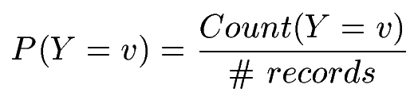

Naïve Bayes Training
Training in Naïve Bayes is easy:
Estimate P(Y=v) as the fraction of records with Y=v
Estimate P(X_{i}=u|Y=v) as the fraction of records with Y=v for which X_{i}=u
(This corresponds to Maximum Likelihood estimation of model parameters)

Slide 26
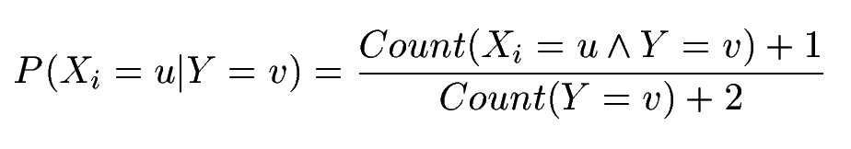
Naïve Bayes Training
In practice, some of these counts can be zero
Fix this by adding “virtual” counts:
(This is like putting a prior on parameters and doing MAP estimation instead of MLE)
This is called Smoothing

Slide 27
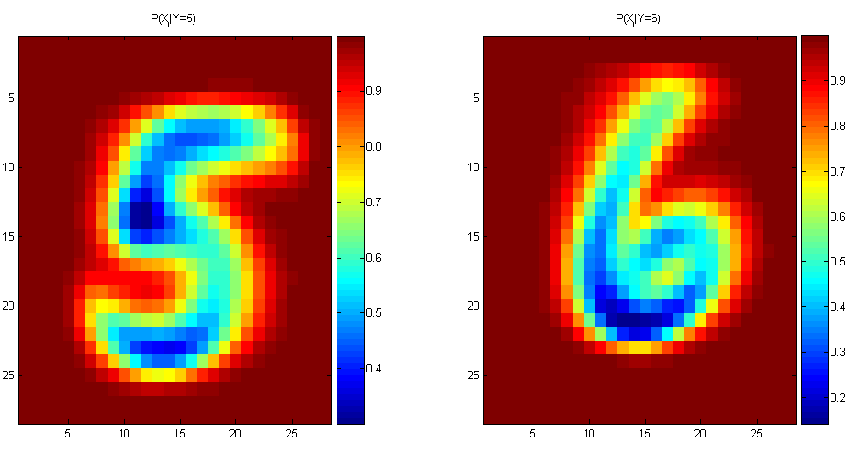
Naïve Bayes Training
For binary digits, training amounts to averaging all of the training fives together and all of the training sixes together.

Slide 28
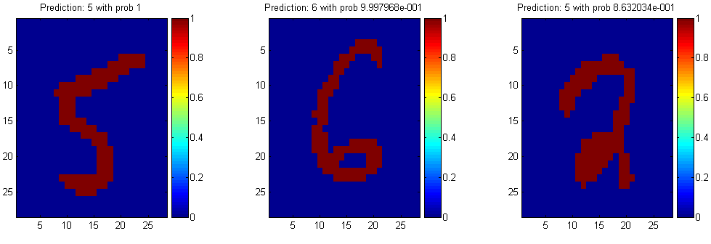
Naïve Bayes Classification

Slide 29
The Naive Bayes Classifier for Data Sets with Numerical Attribute Values
One common practice to handle numerical attribute values is to assume normal distributions for numerical attributes.

Slide 30
Outputting Probabilities
What’s nice about Naïve Bayes (and generative models in general) is that it returns probabilities
These probabilities can tell us how confident the algorithm is
So… don’t throw away those probabilities!

Slide 31
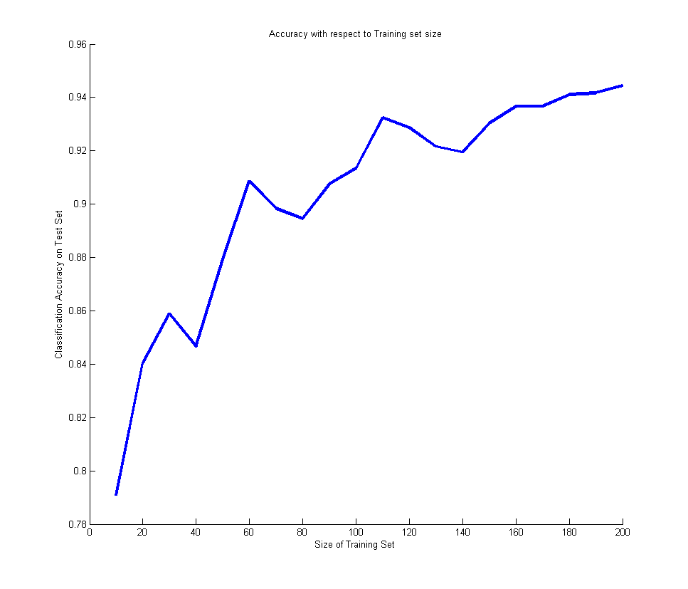
Performance on a Test Set
Naïve Bayes is often a good choice if you don’t have much training data!

Slide 32
Naïve Bayes Assumption
Recall the Naïve Bayes assumption:
that all features are independent given the class label Y
Does this hold for the digit recognition problem?

Slide 33


Recovering the Probabilities
What if we want the probabilities though??
Suppose that for some constant K, we have:
And
How would we recover the original probabilities?

Slide 34
Recap
We defined a Bayes classifier but saw that it’s intractable to compute P(X₁,…,X_{n}|Y)
We then used the Naïve Bayes assumption – that everything is independent given the class label Y
A natural question: is there some happy compromise where we only assume that some features are conditionally independent?
Stay Tuned…

Slide 35
Conclusions
Naïve Bayes is:
Really easy to implement and often works well
Often a good first thing to try
Commonly used as a “punching bag” for smarter algorithms

Slide 36
Evaluating classification algorithms
You have designed a new classifier.
You give it to me, and I try it on my image dataset

Slide 37
Evaluating classification algorithms
I tell you that it achieved 95% accuracy on my data.
Is your technique a success?

Slide 38
Types of errors
But suppose that
The 95% is the correctly classified pixels
Only 5% of the pixels are actually edges
It misses all the edge pixels
How do we count the effect of different types of error?

Slide 39
Types of errors
Prediction
Edge Not edge
Ground Truth
Not Edge Edge
True Positive | False Negative
False Positive | True Negative

Slide 40
Two parts to each: whether you got it correct or not, and what you guessed. For example for a particular pixel, our guess might be labelled…
True Positive
Did we get it correct? True, we did get it correct.
What did we say? We said ‘positive’, i.e. edge.
or maybe it was labelled as one of the others, maybe…
False Negative
Did we get it correct? False, we did not get it correct.
What did we say? We said ‘negative, i.e. not edge.

Slide 41
Sensitivity and Specificity
Count up the total number of each label (TP, FP, TN, FN) over a large dataset. In ROC analysis, we use two statistics:
TP
Can be thought of as the likelihood of spotting a positive case when presented with one.
Or… the proportion of edges we find.
Sensitivity =
TP+FN
TN
Can be thought of as the likelihood of spotting a negative case when presented with one.
Or… the proportion of non-edges that we find
Specificity =
TN+FP

Slide 42
TP
TN
Sensitivity = = ?
Specificity = = ?
TP+FN
TN+FP
Prediction
1
0
60+30 = 90 cases in the dataset were class 1 (edge)
1
60
30
Ground Truth
0
80+20 = 100 cases in the dataset were class 0 (non-edge)
80
20
90+100 = 190 examples (pixels) in the data overall

Slide 43
The ROC space
1.0
This is edge detector A
This is edge detector B
Sensitivity
0.0
1.0
1 - Specificity
Note

Slide 44
The ROC Curve
Draw a ‘convex hull’ around many points:
Sensitivity
This point is not on the convex hull.
1 - Specificity

Slide 45
ROC Analysis
All the optimal detectors lie on the convex hull.
Which of these is best depends on the ratio of edges to non-edges, and the different cost of misclassification
Any detector on this side can lead to a better detector by flipping its output.
sensitivity
1 - specificity
Take-home point : You should always quote sensitivity and specificity for your algorithm, if possible plotting an ROC graph. Remember also though, any statistic you quote should be an average over a suitable range of tests for your algorithm.

Slide 46
Holdout estimation
What to do if the amount of data is limited?
The holdout method reserves a certain amount for testing and uses the remainder for training
➔Usually: one third for testing, the rest for training

Slide 47
Holdout estimation
Problem: the samples might not be representative
Example: class might be missing in the test data
Advanced version uses stratification
Ensures that each class is represented with approximately equal proportions in both subsets

Slide 48
Cross-validation
Cross-validation avoids overlapping test sets
First step: split data into k subsets of equal size
Second step: use each subset in turn for testing, the remainder for training
Called k-fold cross-validation

Slide 49
Cross-validation
Often the subsets are stratified before the cross-validation is performed
The error estimates are averaged to yield an overall error estimate

Slide 50
More on cross-validation
Standard method for evaluation: stratified ten-fold cross-validation
Why ten?
Empirical evidence supports this as a good choice to get an accurate estimate
There is also some theoretical evidence for this
Stratification reduces the estimate’s variance
Even better: repeated stratified cross-validation
E.g. ten-fold cross-validation is repeated ten times and results are averaged (reduces the variance)

Slide 51
Leave-One-Out cross-validation
Leave-One-Out: a particular form of cross-validation:
Set number of folds to number of training instances
I.e., for n training instances, build classifier n times
Makes best use of the data
Involves no random subsampling
Very computationally expensive
(exception: NN)

Slide 52
Leave-One-Out-CV and stratification
Disadvantage of Leave-One-Out-CV: stratification is not possible
It guarantees a non-stratified sample because there is only one instance in the test set!

Slide 53
Questions?

